Slide 1
Cryptography
Classical Cryptography
Quantum Cryptography

Slide 2
QKD Protocols
Classical Cryptography
Quantum Cryptography

Slide 3
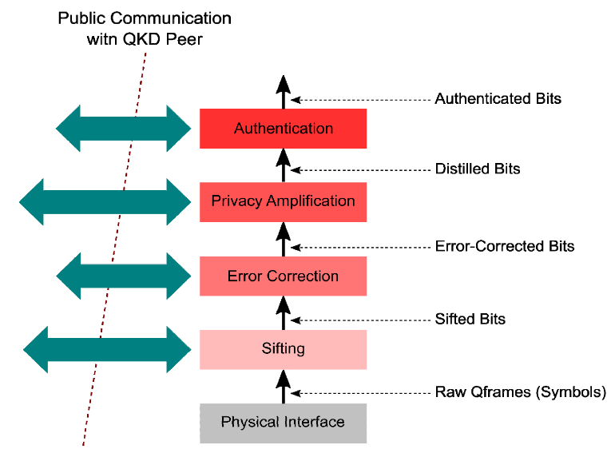
Public Communication with QKD Peer
Physical Interface
Sifting
Error Correction
Privacy Amplification
Authentication
Raw Qframes (Symbols)
Sifted Bits
Error-Corrected Bits
Distilled Bits
Authenticated Bits

Slide 4
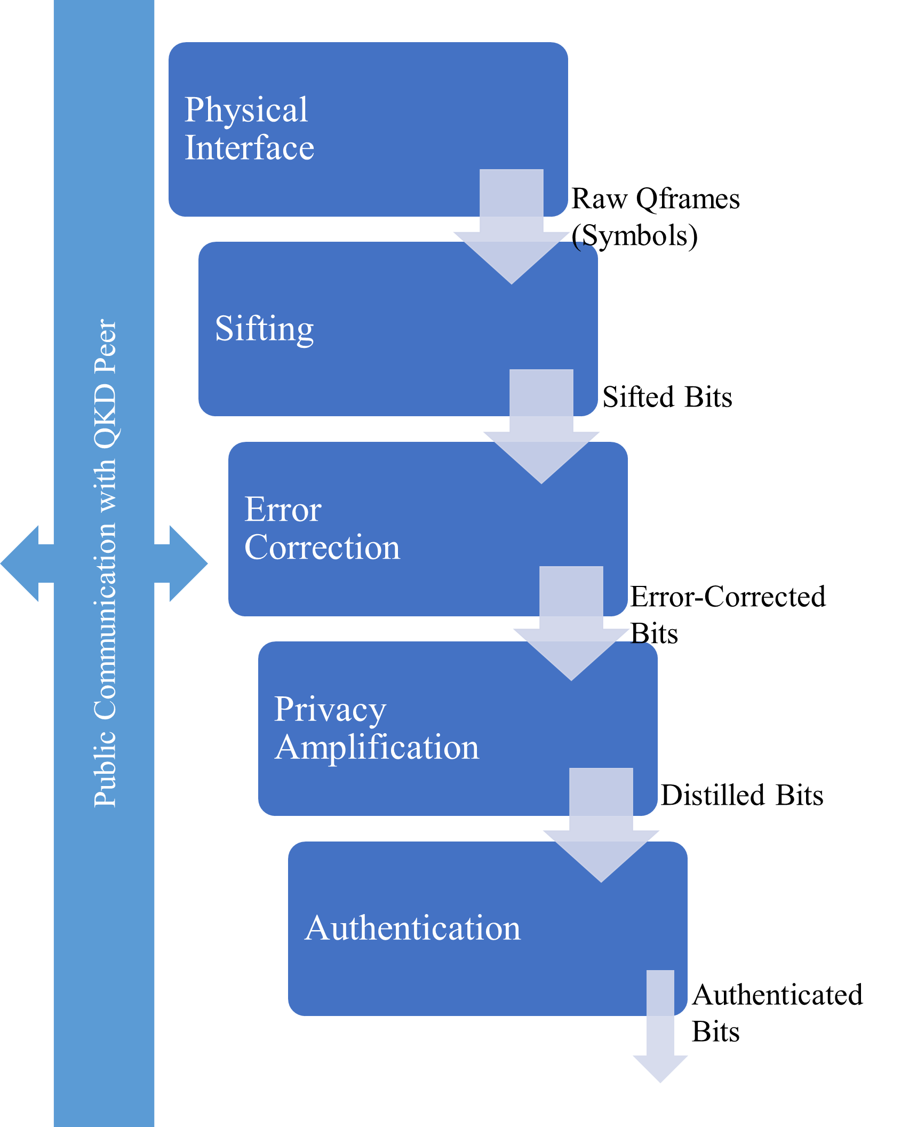

Slide 5
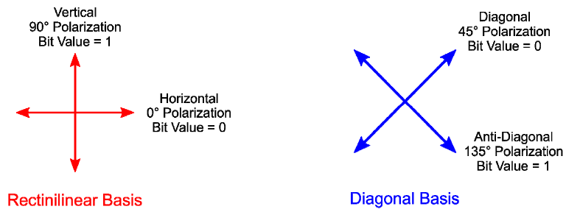
Vertical
90º Polarization
Bit Value = 1
Horizontal
0º Polarization
Bit Value = 0
Rectilinear Basis

Slide 6
Diagonal
45º Polarization
Bit Value = 0
Anti-Diagonal
135º Polarization
Bit Value = 1
Diagonal Basis

Slide 7
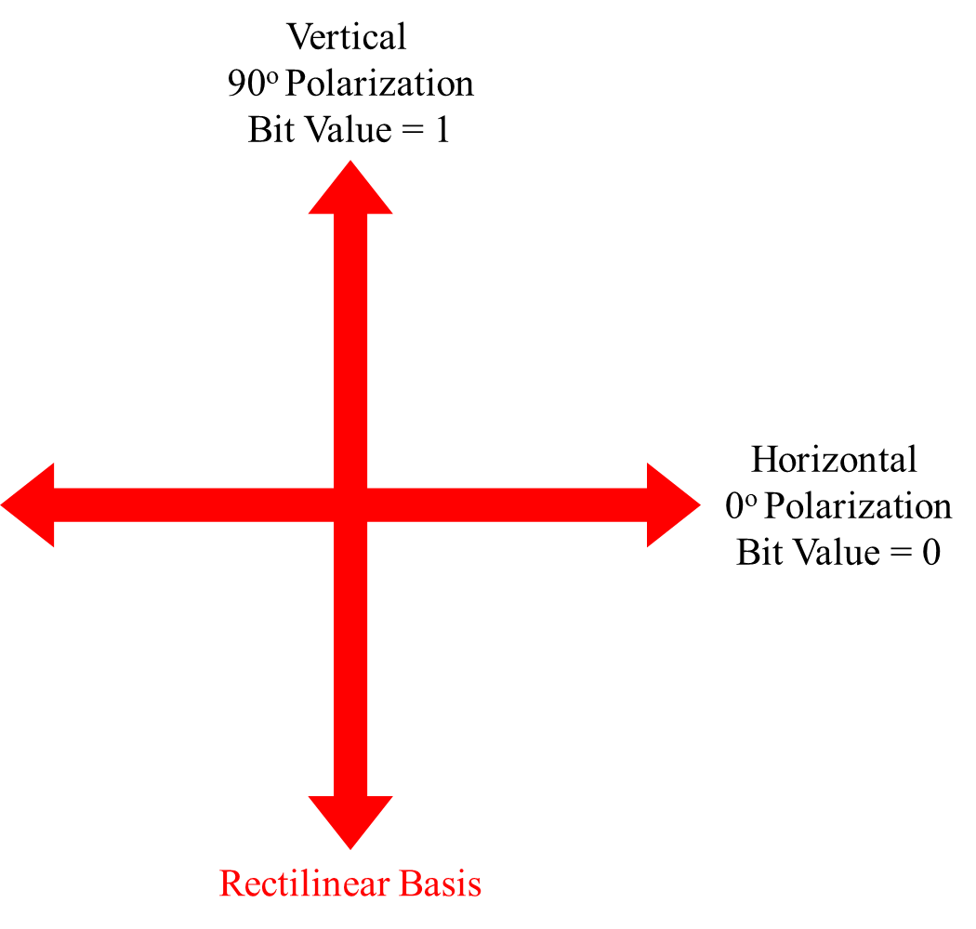
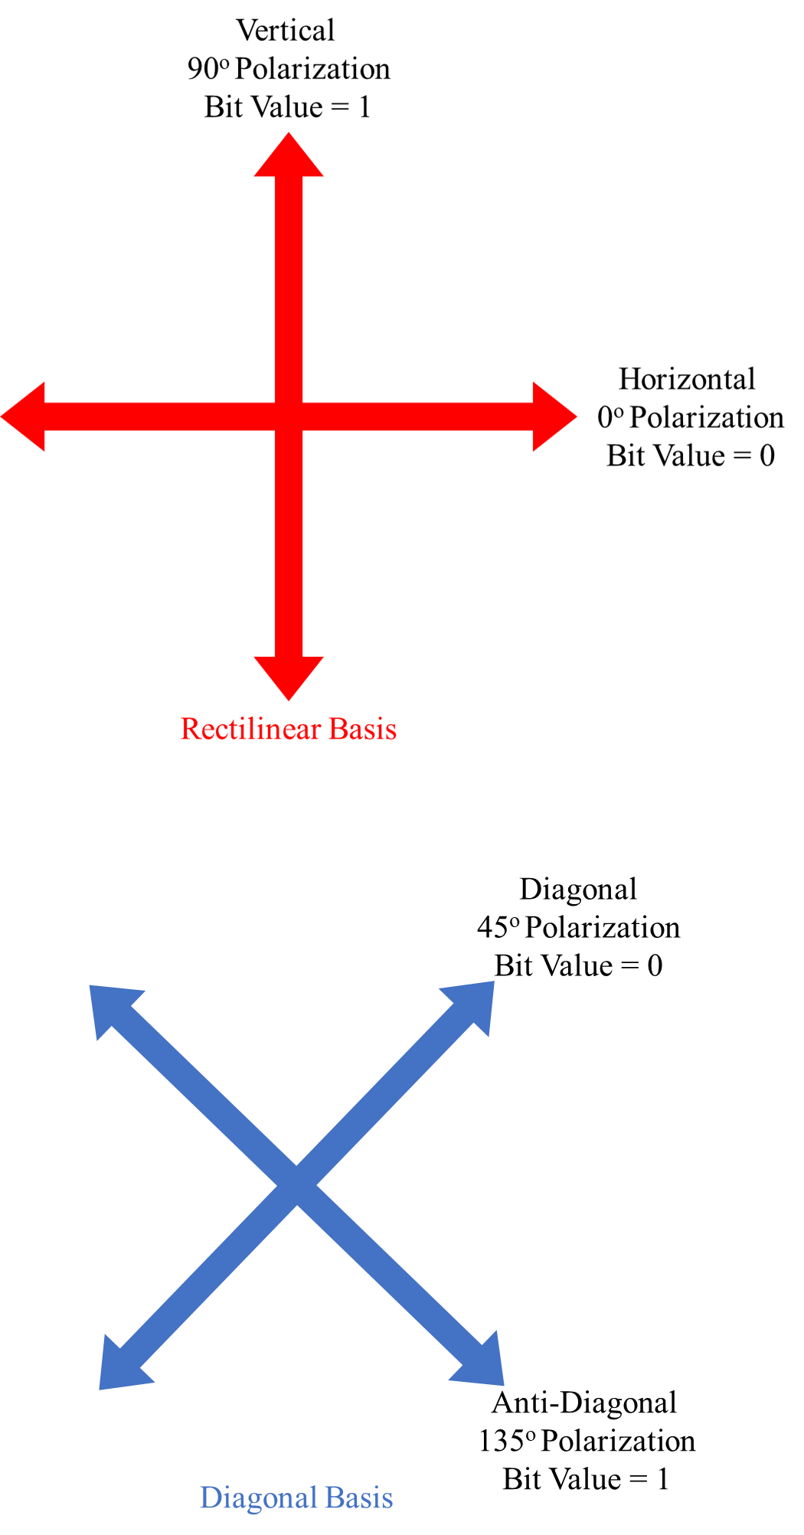
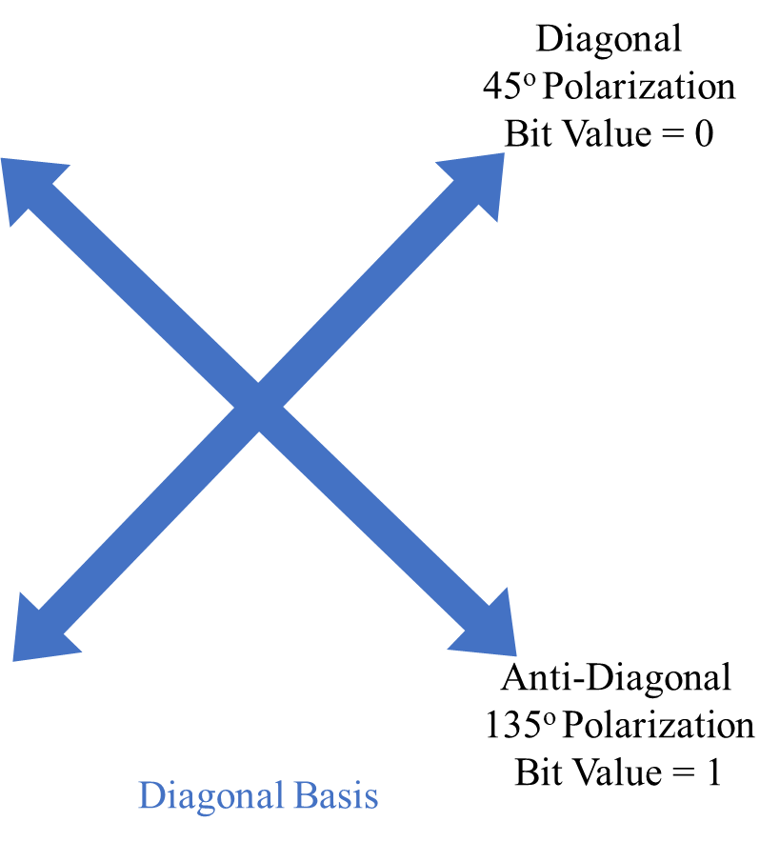

Slide 8
Quantum Exchange
Key Sifting
Information Reconciliation
Privacy Amplification
Quantum Exchange
Key Sifting
Information Reconciliation
Privacy Amplification

